Slide 1
MARKETING
CONTINUATION…

Slide 2
Marketing information system
A marketing information system (MIS) is a management information system (MIS) designed to support marketing decision making.

Slide 3
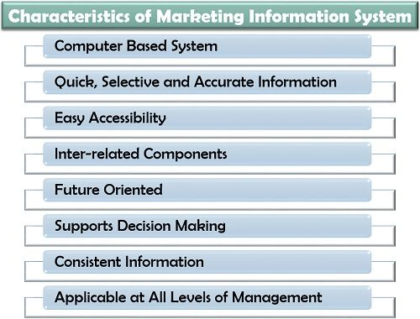

Slide 4
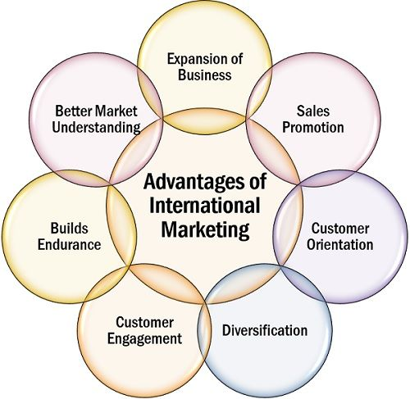
International marketing
International marketing refers to any marketing activity that occurs across borders.

Slide 5
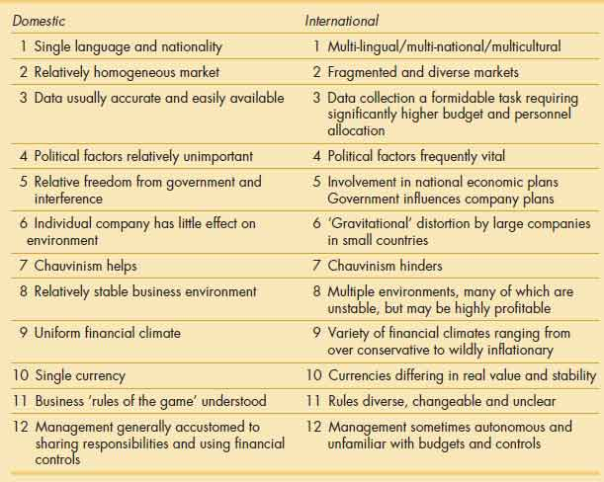
Difference between Domestic marketing and international marketing

